Slide 1
Name: Swapnil Ghosh
Group: A2
Roll: 001911001067
TASK 20

Slide 2

Step- 1) Created a new file 600 by 400 pixels.
Step- 2) Set the white as foreground color and black as the background color.
Step- 3) Created a new layer above text layer and rename the new layer as Fire.
Step- 4) Selecting layer Fire press CTRL+ALT+SHIFT+E. The selected layer is stamped with the contents of all visible layers.
Step- 5) Selecting the layer Fire choose Edit > Transform > Rotate > 90 CCW.
Step- 6) Choose the Filter > Stylize > Wind.
Step- 7) Choose the Edit > Transform > Rotate > 90 CW.
Step- 8) Choose the Image > Adjust > Hue Saturation and Activate Colorize option, set Hue 40, Sat 100.
Step-9) Duplicate Fire layer.
Step- 10) Selecting the Fire Copy layer choose Image > Adjust > Hue Saturation and set Hue to -40.

Slide 3
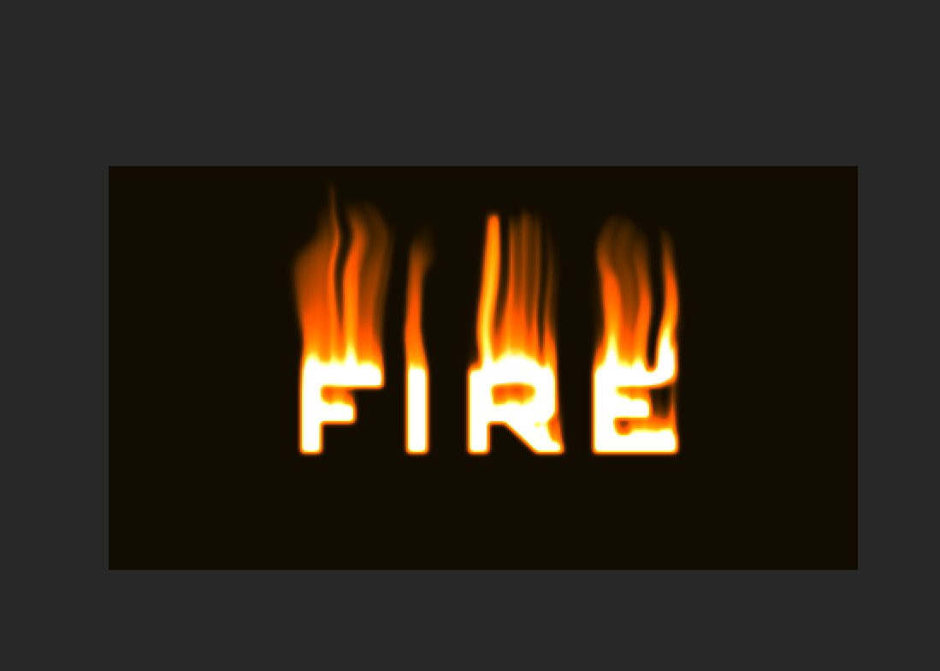
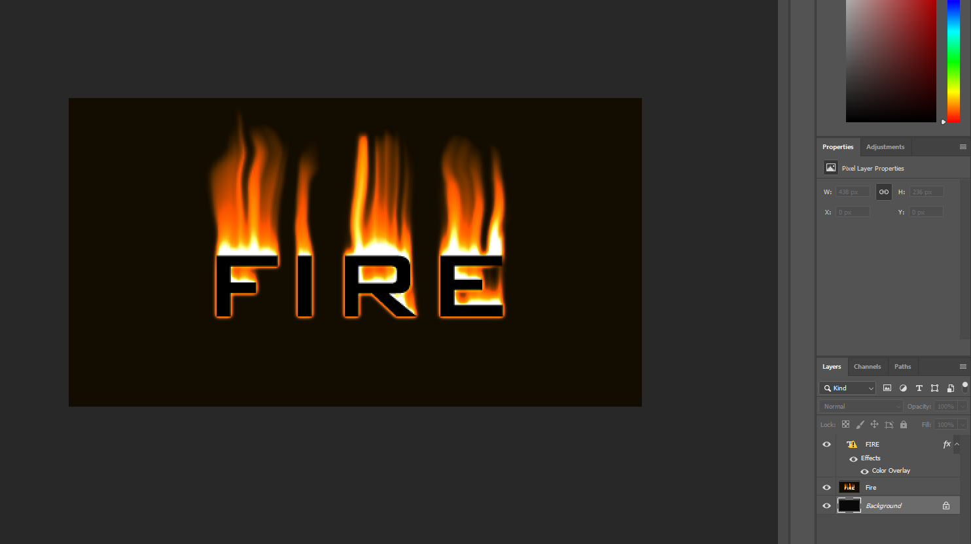
Step- 11) Set the blending mode of Fire Copy layer to Color Dodge.
Step- 12) Merge down with Fire layer by choosing Layer > Merge Down.
Step- 13) Selecting the layer Fire, choose Filter > Liquify.
Step -14) Using Warp tool, brush size 50, brush pressure 40, drag flame up in curved paths.Repeated the above operation using brush size 30, brush pressure 35.
Step -15) Moved the text layer to the top and make text color black.

